Slide 1

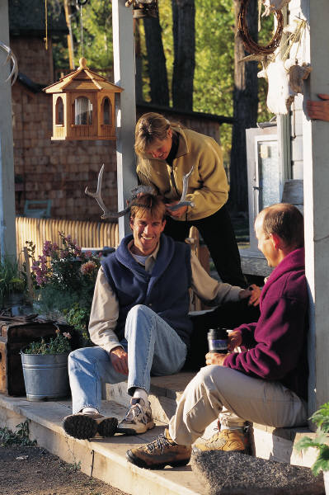
Formal vs Informal
What’s up?
May I Help You?
Ms. Shuler
6th Grade English Language Arts
Heyward Gibbes Middle School

Slide 2

Why is Language Important?
Communication
Culture
Adds knowledge
Expression
Can you think of any other reasons?

Slide 3
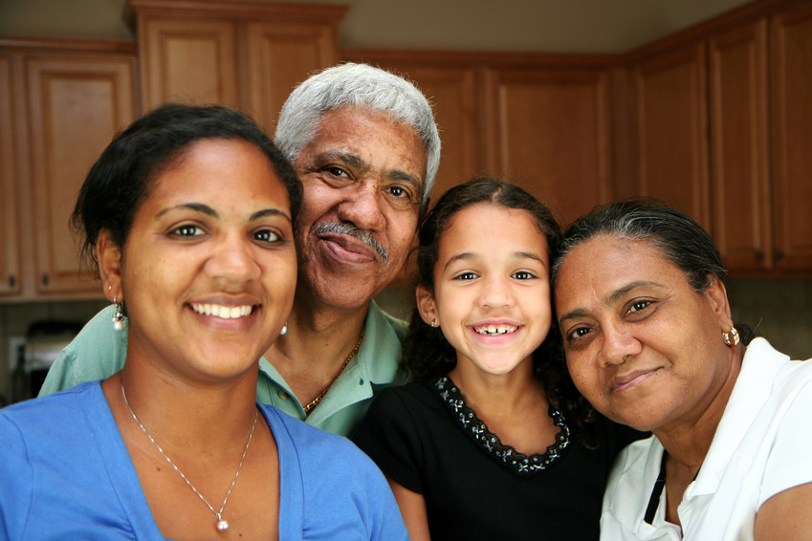
Home Language
How do you speak at home? Around friends and family?
Spoken around family and friends
Does not follow grammatical rules
Also called informal language
Relaxed, comfortable

Slide 4
Examples
“Wanna go to the store?”
Come here.
Ay what’s up?
She ain’t go to work today.
He off tomorrow so we going to the beach.
I dunno.
Share with your neighbor some terms, phrases or sayings you say outside of school around family or friends?

Slide 5
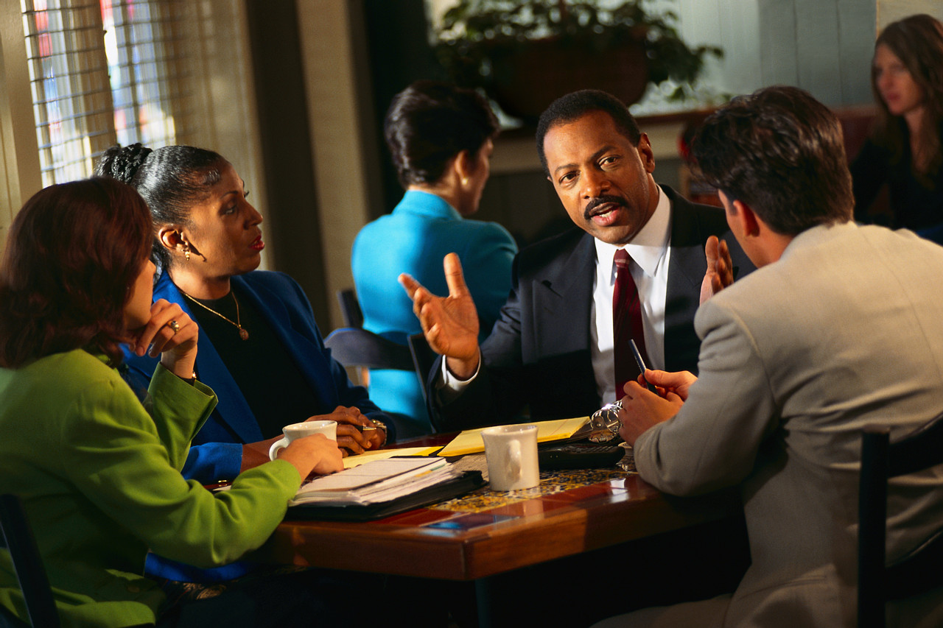
Standard American English
Follows grammar rules
Spoken in settings such as school, work, professional settings, interviews, and/or meetings with physician, tax preparer, or managers.

Slide 6

Examples
Thanks for joining our team.
Hello Mr. Preston.
We are meeting to discuss your work.
What are some instances where you would use S.A.E

Slide 7
Formal or Informal?
You call your dad at work and his boss answers the phone.
You are asking someone out on a date
You are talking to your parents at the dinner table
You are trying to convince the assistant principal to change the date of the detention you were given.

Slide 8
Change to Formal
Hi
Sure!
Will ya?
Ya gotta do it!
What do you want?

Slide 9
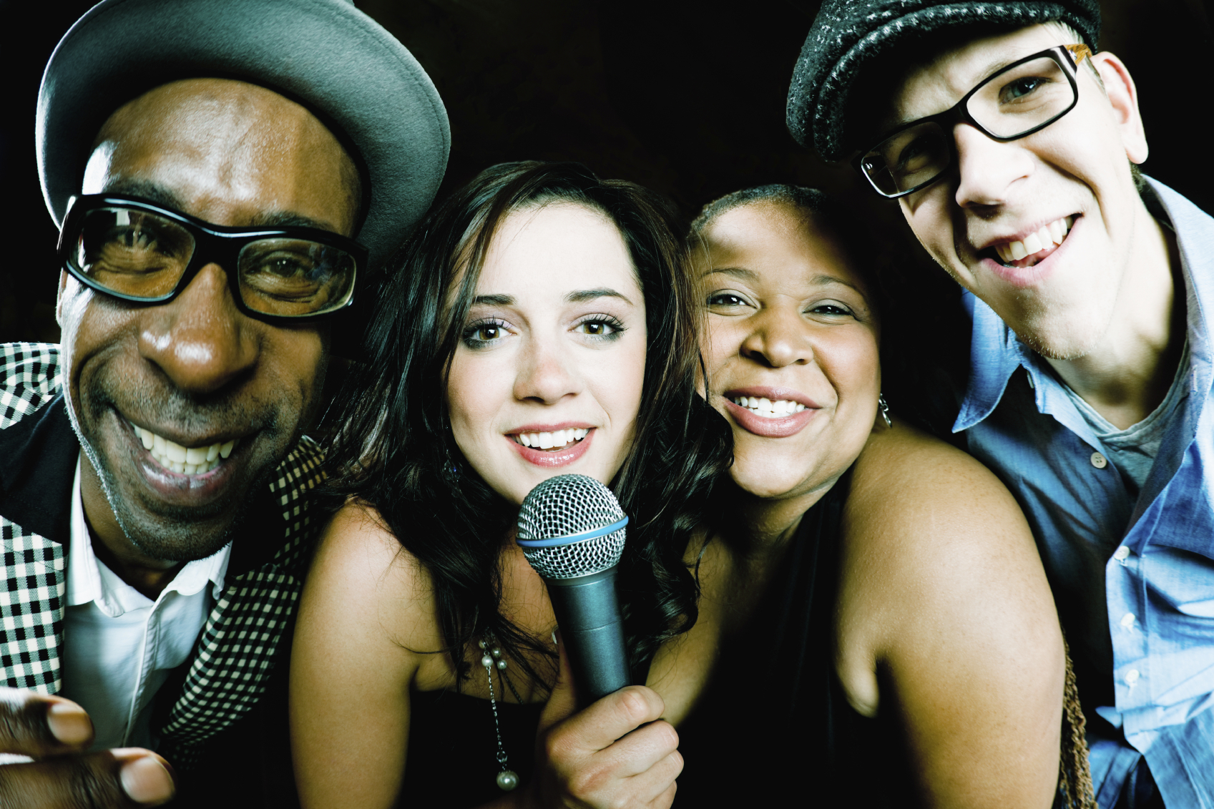
It’s Cool!
You should remember to adapt your language to the setting you are in at the time.
What’s the difference?

Slide 10
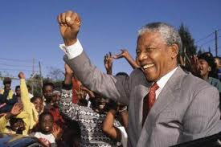
Final Thought
If you talk to a man in a language he understands, that goes to his head. If you talk to him in his language, that goes to his heart. Nelson Mandela

